Slide 1

Welcome to Contract Monthly Claim Presentation
Proudly Presented to you By Mr.Mbatha
ST10070515

Slide 2
Introduction & Problem Statement
What is CMCS?
A .NET web-based application to streamline monthly claims.
The Challenge:
Complex, time-consuming manual processes for IC Lecturer claim submissions, verification, and approval.
Our Goal:
Enhance efficiency, accuracy, and user satisfaction.

Slide 3
Architecture & Design
Technology Stack
Built using C# and ASP.NET Core MVC (or relevant framework).
Database Structure
Briefly present the core entities and relationships from your UML Class Diagram.

Slide 4
Lecturer View: Claim Submission & Automation
Core Functionality
Lecturers easily submit claims with hours worked and hourly rate.
Automation Highlight
Auto-Calculation feature computes the final payment upon submission of claim and can be viewed in the lecturer Dashboard.
Accuracy Highlight
Client-side Validation Checks ensure accurate data entry.

Slide 5
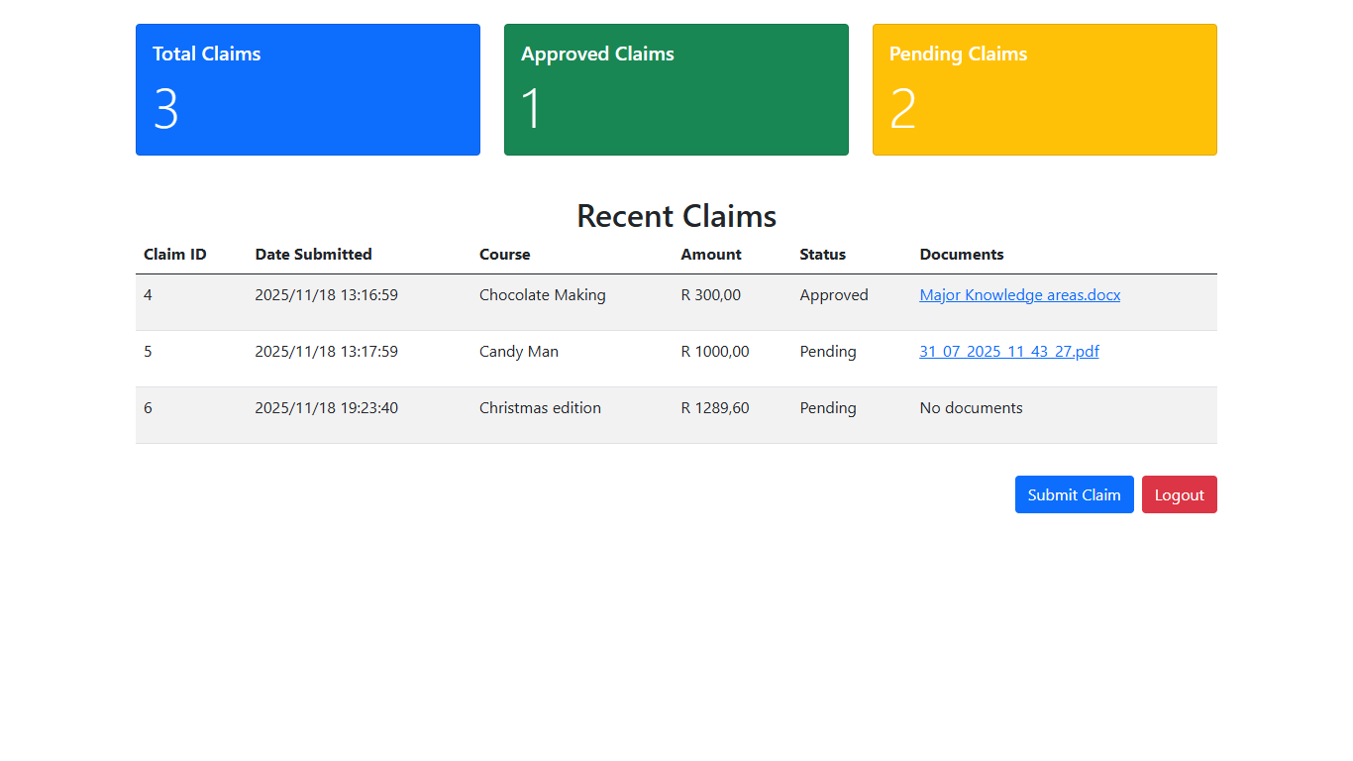
Introduction & Problem Statement
Content

Slide 6
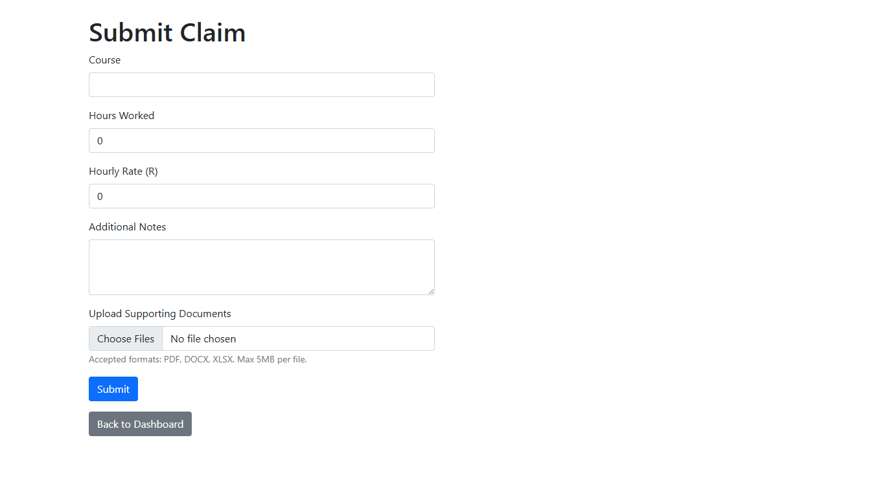
Introduction & Problem Statement

Slide 7
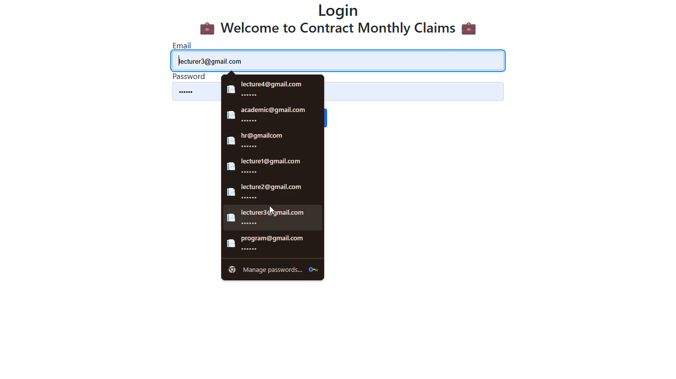
Introduction & Problem Statement
Please show validation screenshot

Slide 8
Lecturer View: Tracking & Documents
Supporting Documents
Simple feature to upload documents (PDF, DOCX, XLSX) securely.
Claim Status Tracking
Transparent, real-time status update (Pending, Approved, Rejected) for reliability.

Slide 9
Introduction & Problem Statement
Content

Slide 10
Introduction & Problem Statement
Content

Slide 11
Coordinator/Manager View: Verification Automation
Dashboard View:
Clear, organized dashboard showing all pending claims.
Workflow Highlight:
Integration of Approval Workflows to streamline verification

Slide 12
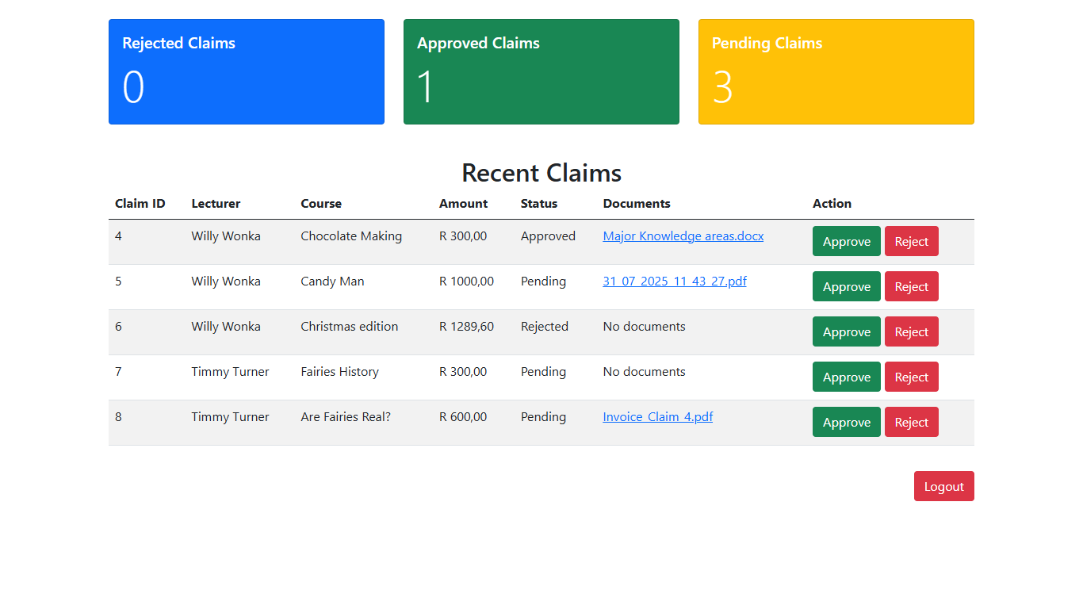
Pics
Content

Slide 13
Security & Reliability
User Authentication
Use of Database integrated for user authentication and authorization.
Error Handling
Graceful error handling mechanisms displaying meaningful messages (e.g., during file upload)

Slide 14
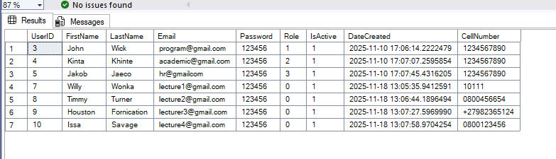

Slide 15
HR View: Processing & Data Management
Automation Highlight
Functionality to automatically generate Invoices for payment processing.
Data Management
Features to manage and update lecturer personal/contact information.

Slide 16
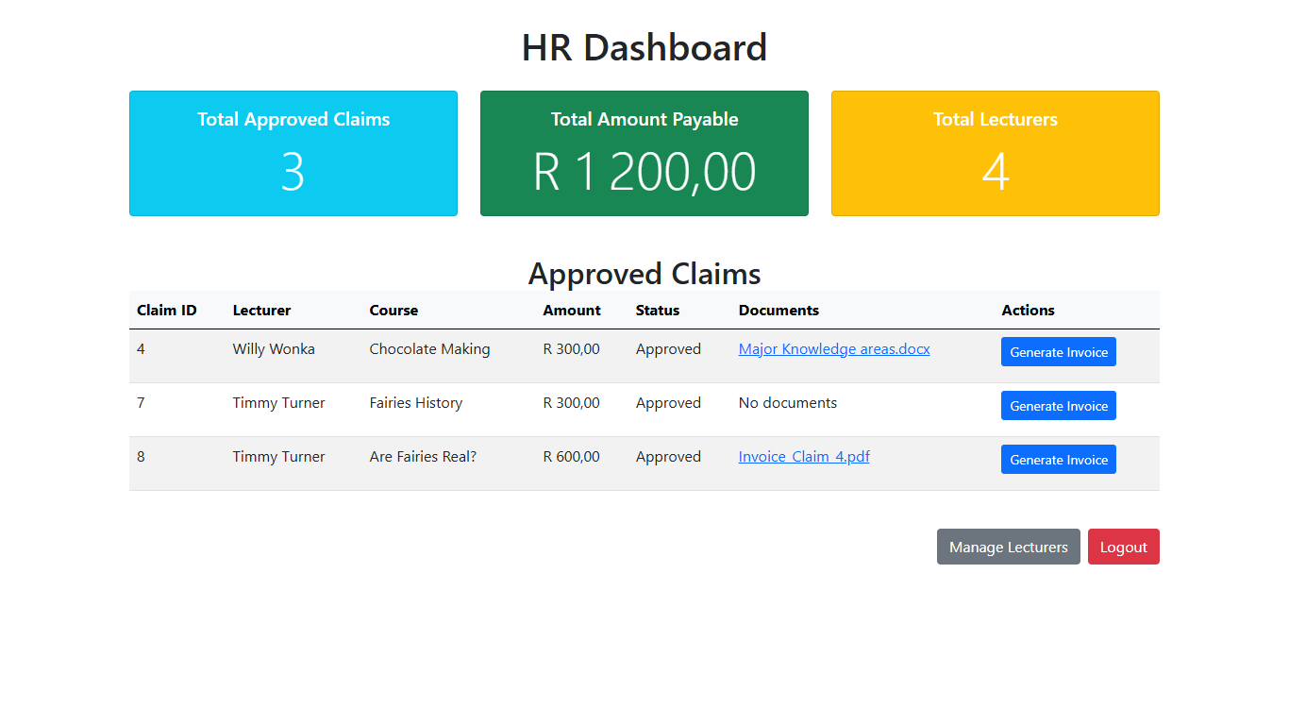
Pics
Content

Slide 17
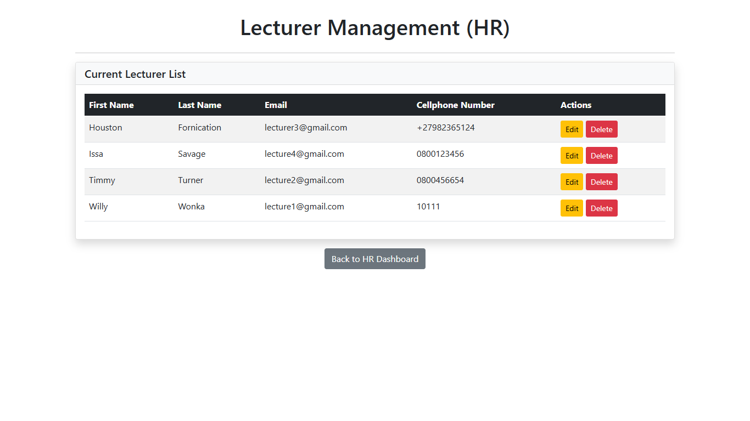
Pics
Content

Slide 18
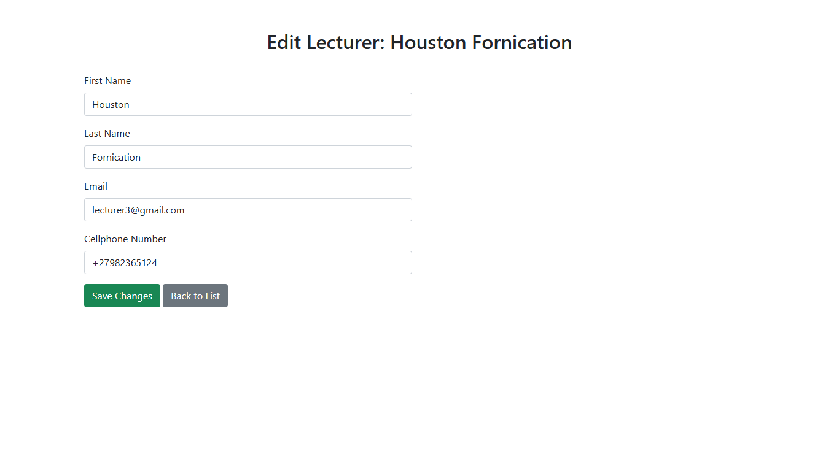
Pics
Content

Slide 19
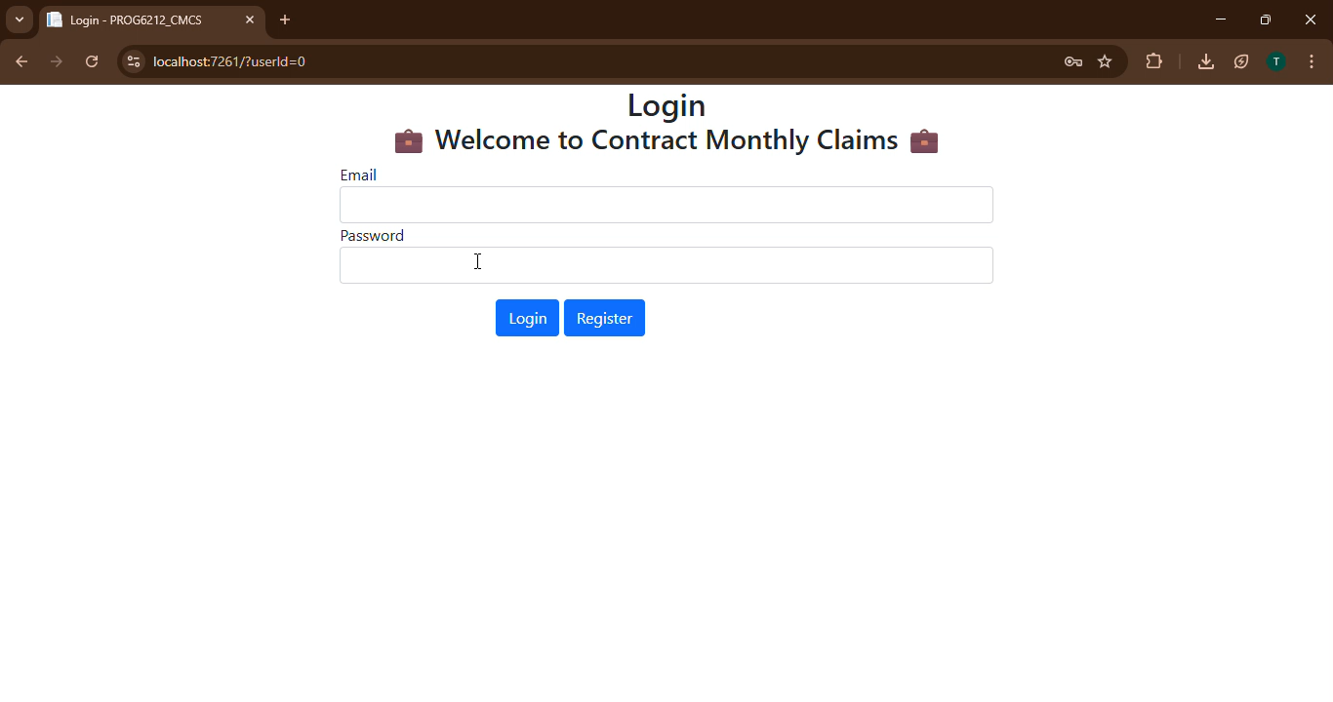
Pics
Content

Slide 20
Conclusion & Future Enhancements
Summary of Value: Reiterate how CMCS revolutionizes claim management (e.g., saving time, reducing errors). * Future Features: (Optional) Suggest one or two features you would add next to further improve the system

